Slide 1
RAILWAY RESERVATION SYSTEM
GROUP PROJECT
.CHHANDA NASKAR 12110668
. UTKARSH SRIVASTAVA 12110669
. ASHWANI KUMAR 12110667
SUBMITTED TO: UPINDER KAUR

Slide 2
INTRODUCTION
General Overview
Our website has various kinds of information that helps regarding booking of tickets via railways . Users will be able to search the train availability ,the exact fare
,the arrival and departure time of the train .
Survey
Railway passengers frequently need to know about their ticket reservation status, ticket availability on a particular train or for a place, train arrival or departure details, special trains etc.. Customer information centers at the railway stations are unable to serve such queries at peak periods. The number of the reservation counters available to the passengers and customers are very less. On most of the reservation systems there are long queues, so it takes a long time for any individual to book the ticket. As now there are no call centers facilities available to solve the queries of the passengers.

Slide 3
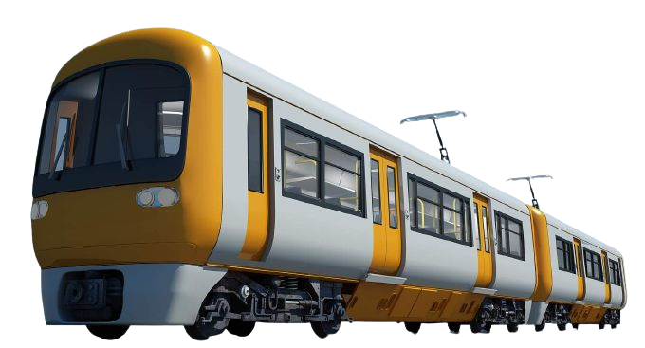
RAILWAY
The online railway ticket reservation system aims to develop a web application which aims at providing trains details, trains availability, as well as the facility to book ticket in online for customers. So, we thought of developing a web based application which would provide the users all these facilities from his terminal only as well as help them in booking their tickets. The Application was to be divided into two parts namely the user part , and the administrator part. And each of these has their corresponding features. We decided to give the name of the website “ONLINE RAILWAY TICKET RESERVATION”. The online railway ticket reservation system is developed using ASP.NET with C# as the backend in the .NET Framework.

Slide 4
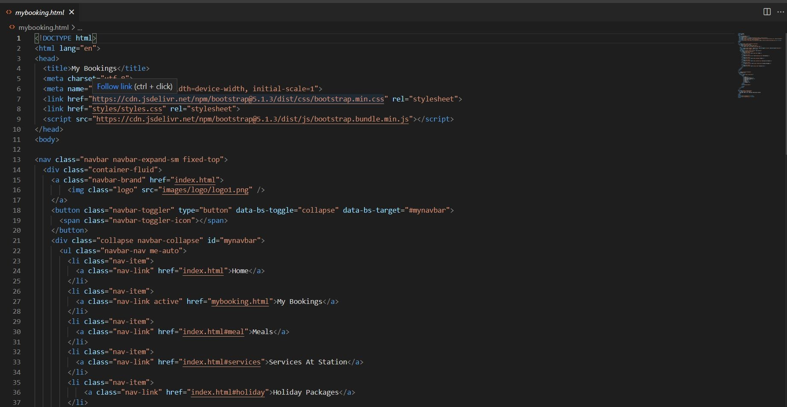
BY CHHANDA: MYBOOKING

Slide 5
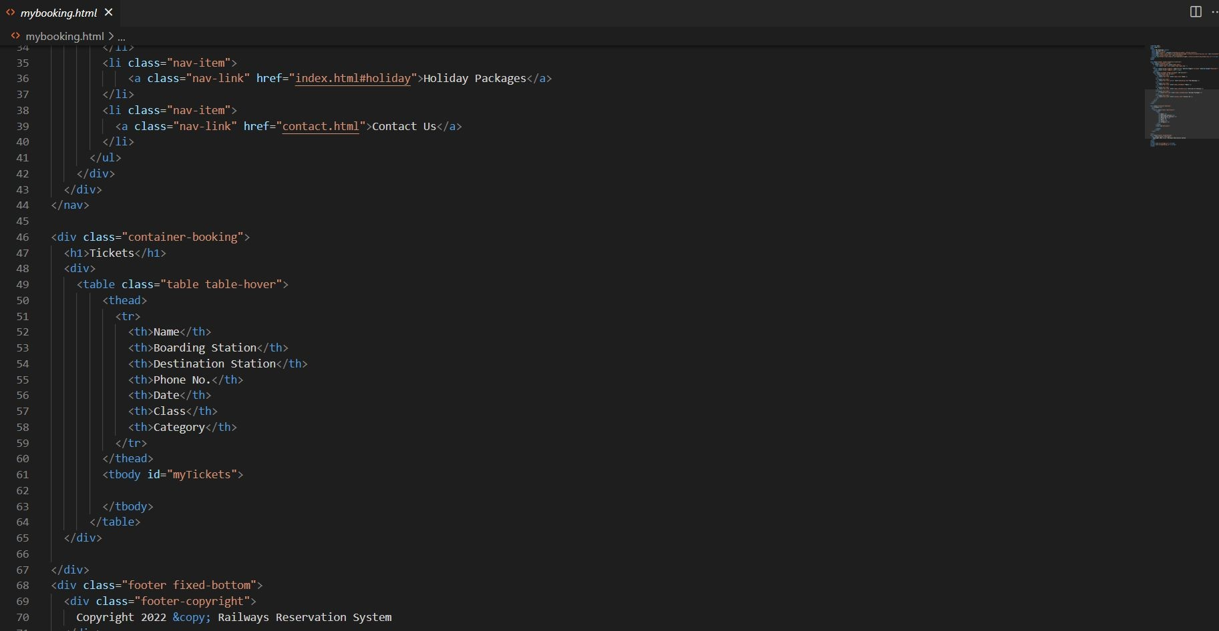

Slide 6
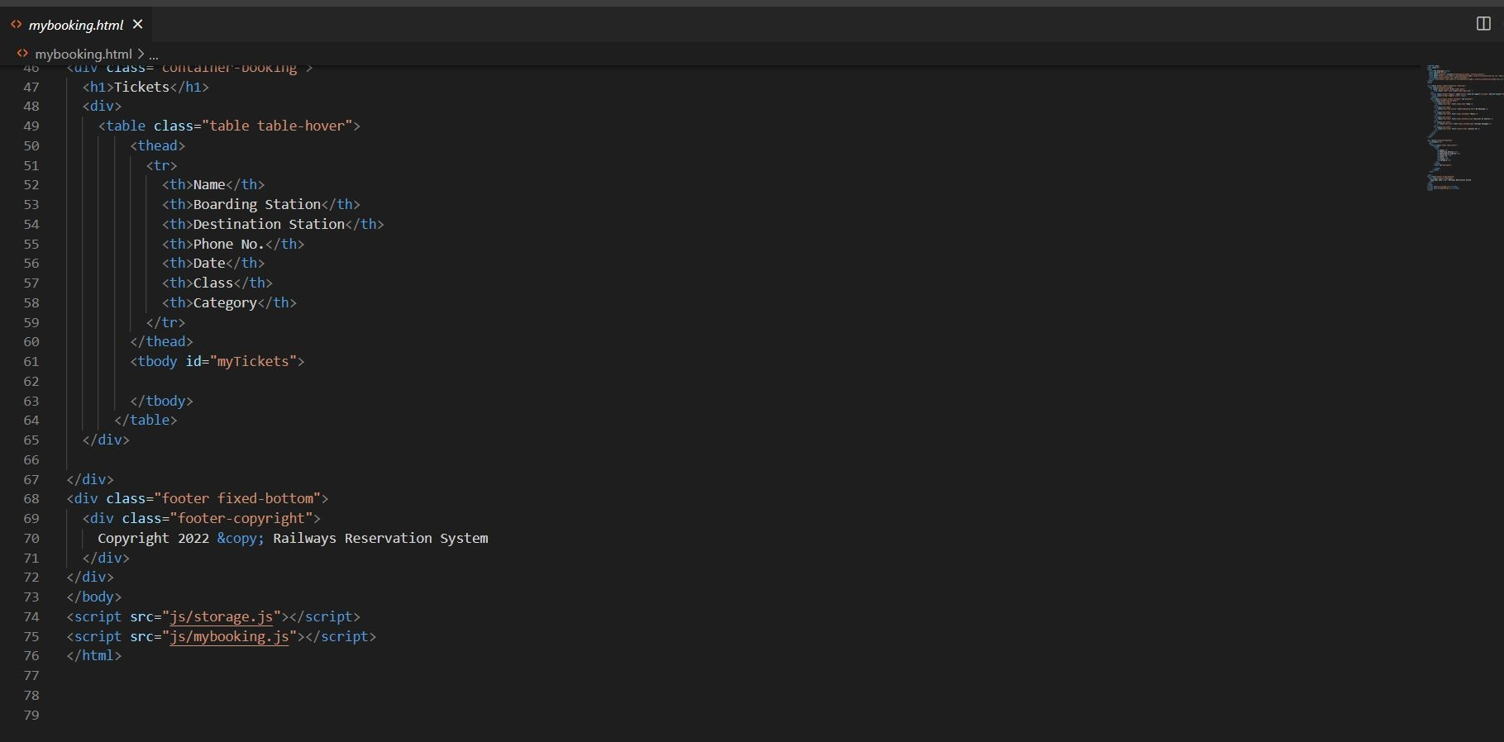

Slide 7
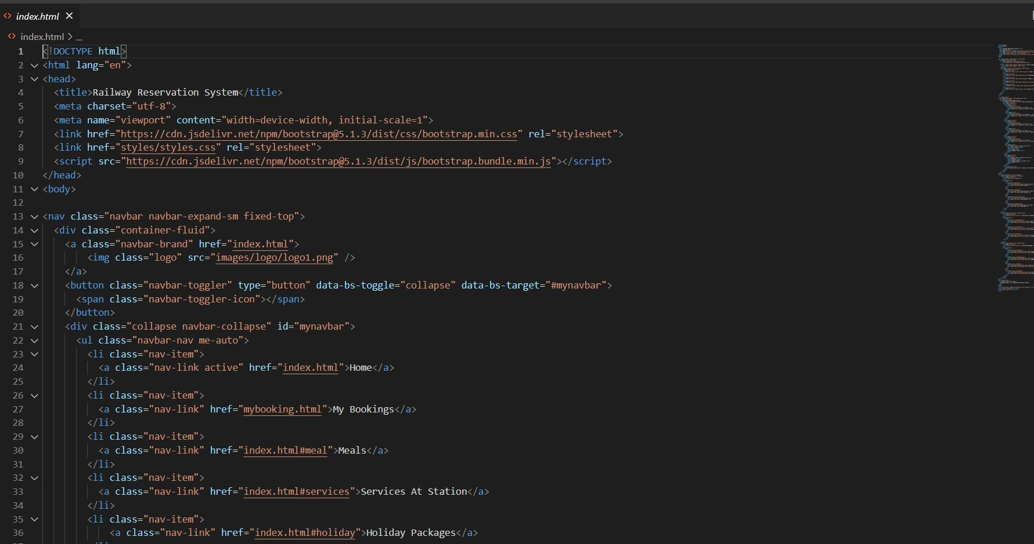
BY CHHANDA: INDEX

Slide 8
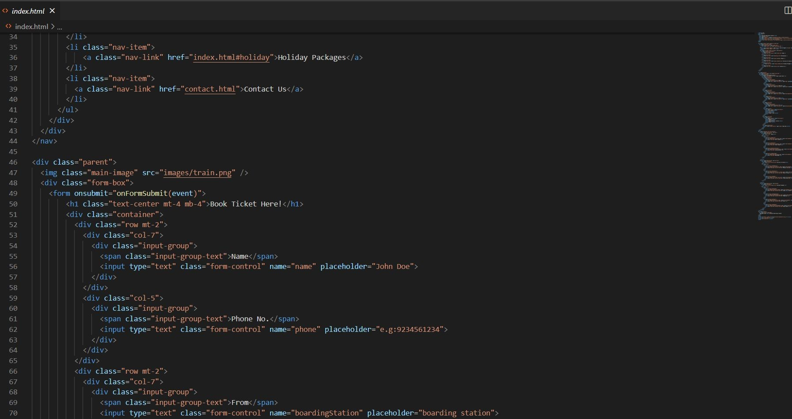

Slide 9
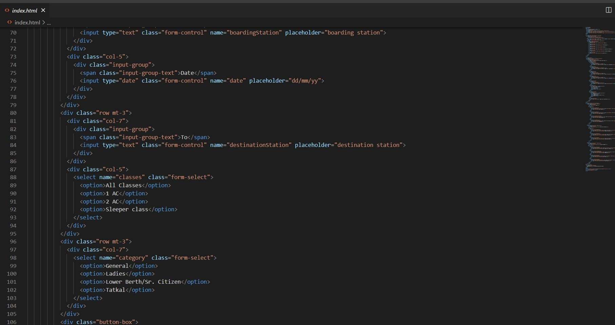

Slide 10
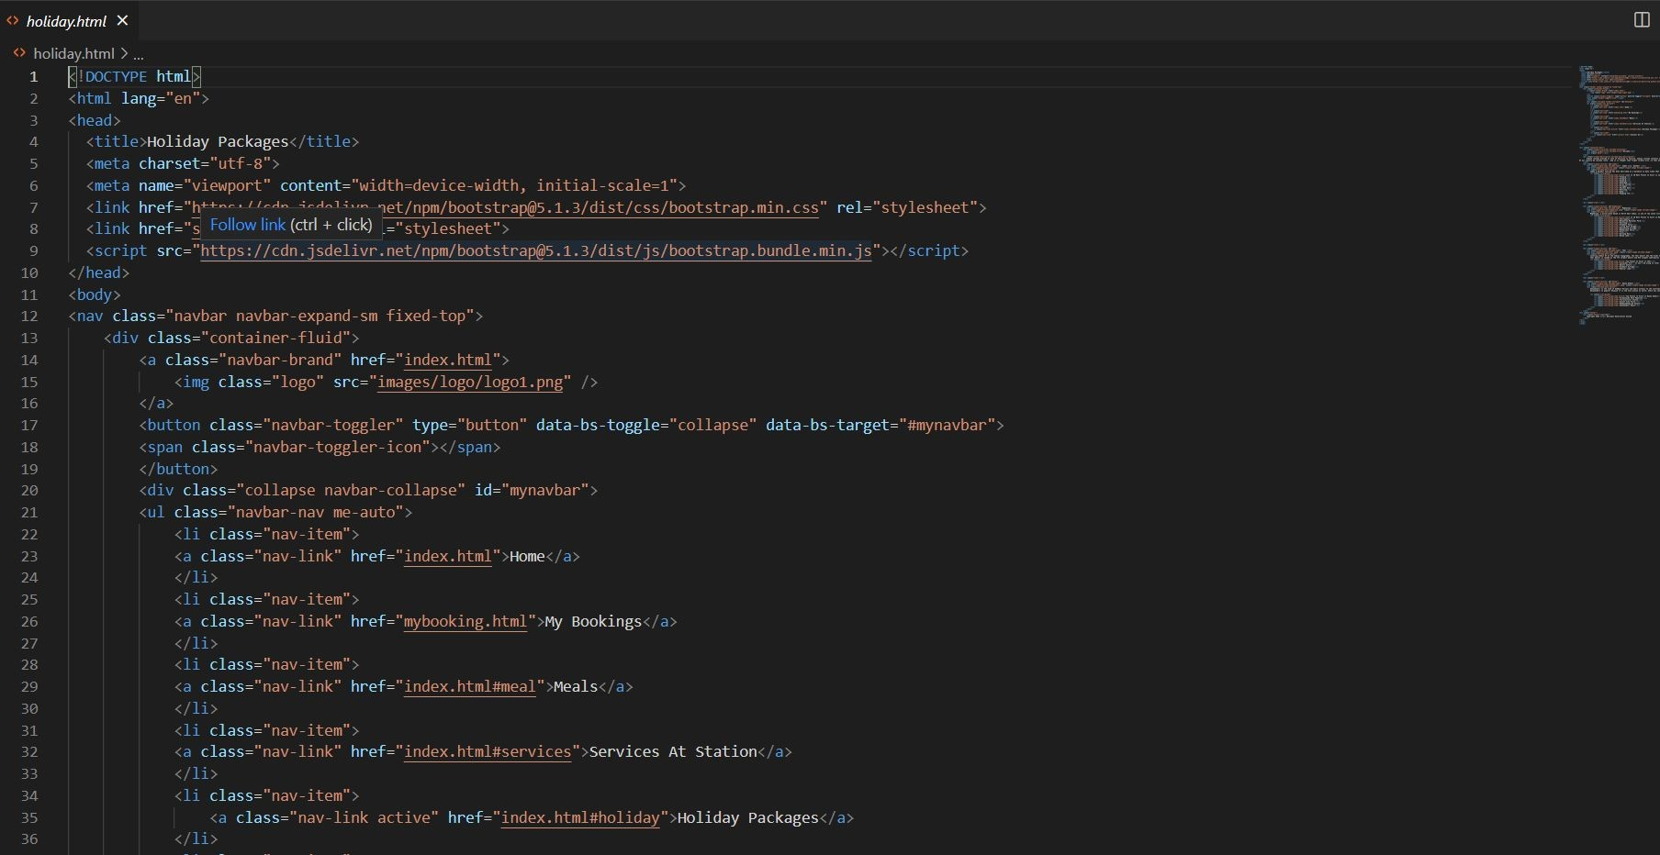
BY ASHWANI: HOLIDAY

Slide 11
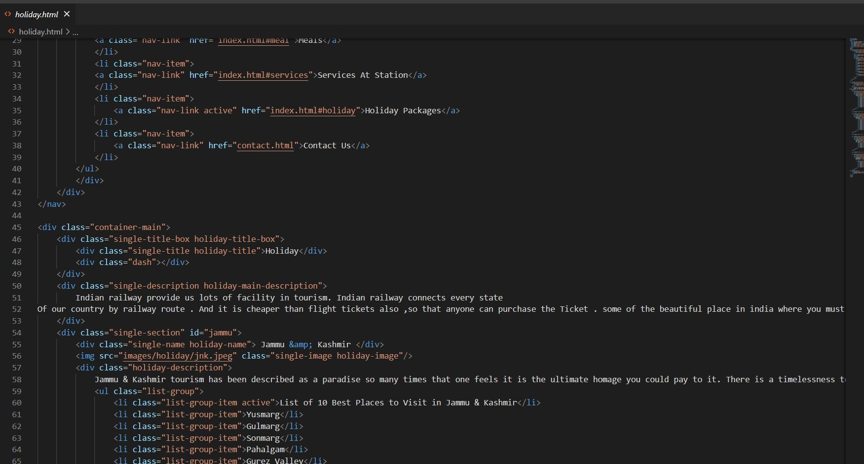

Slide 12
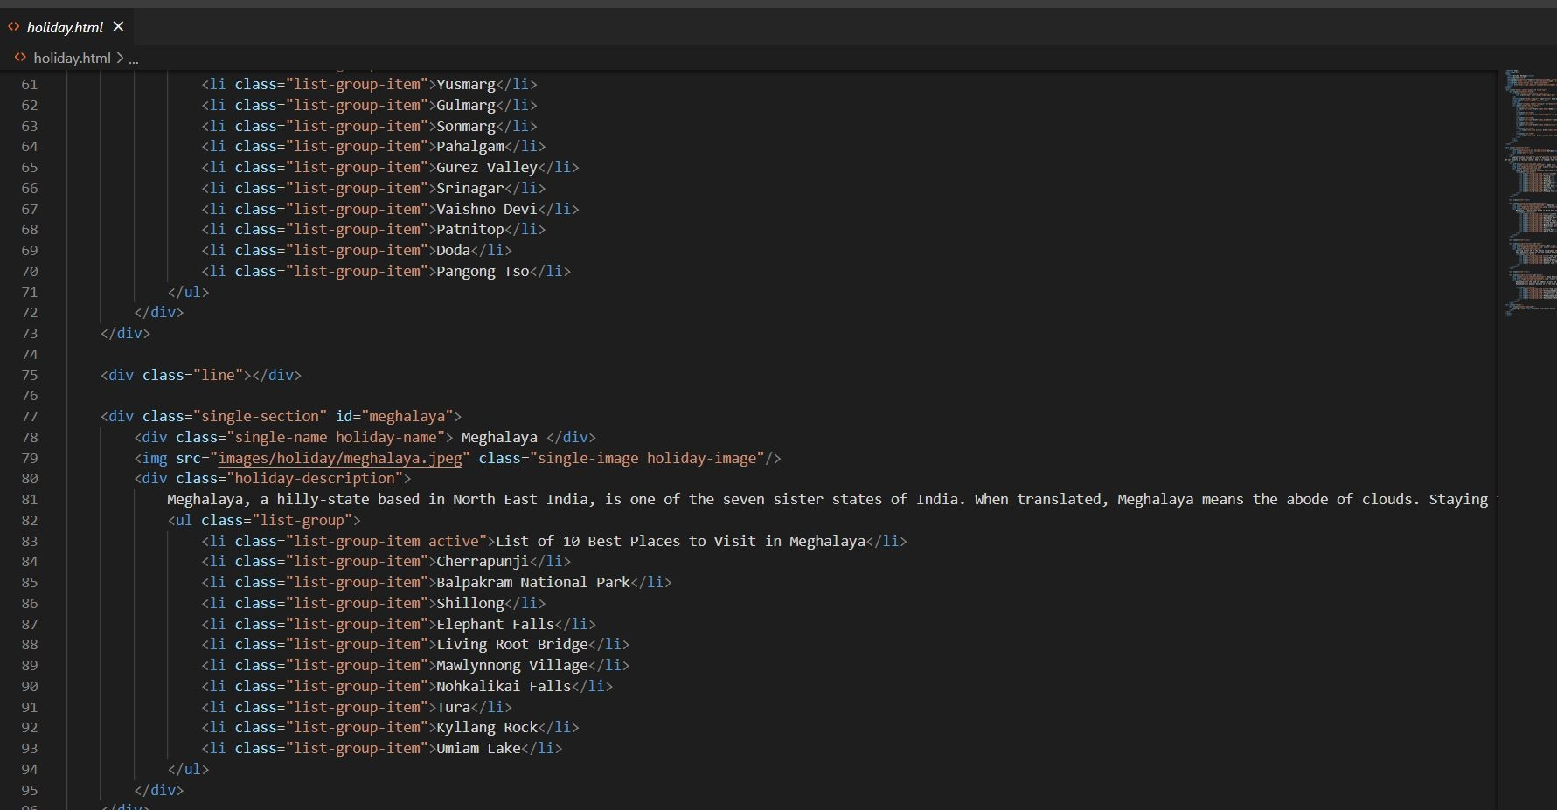

Slide 13
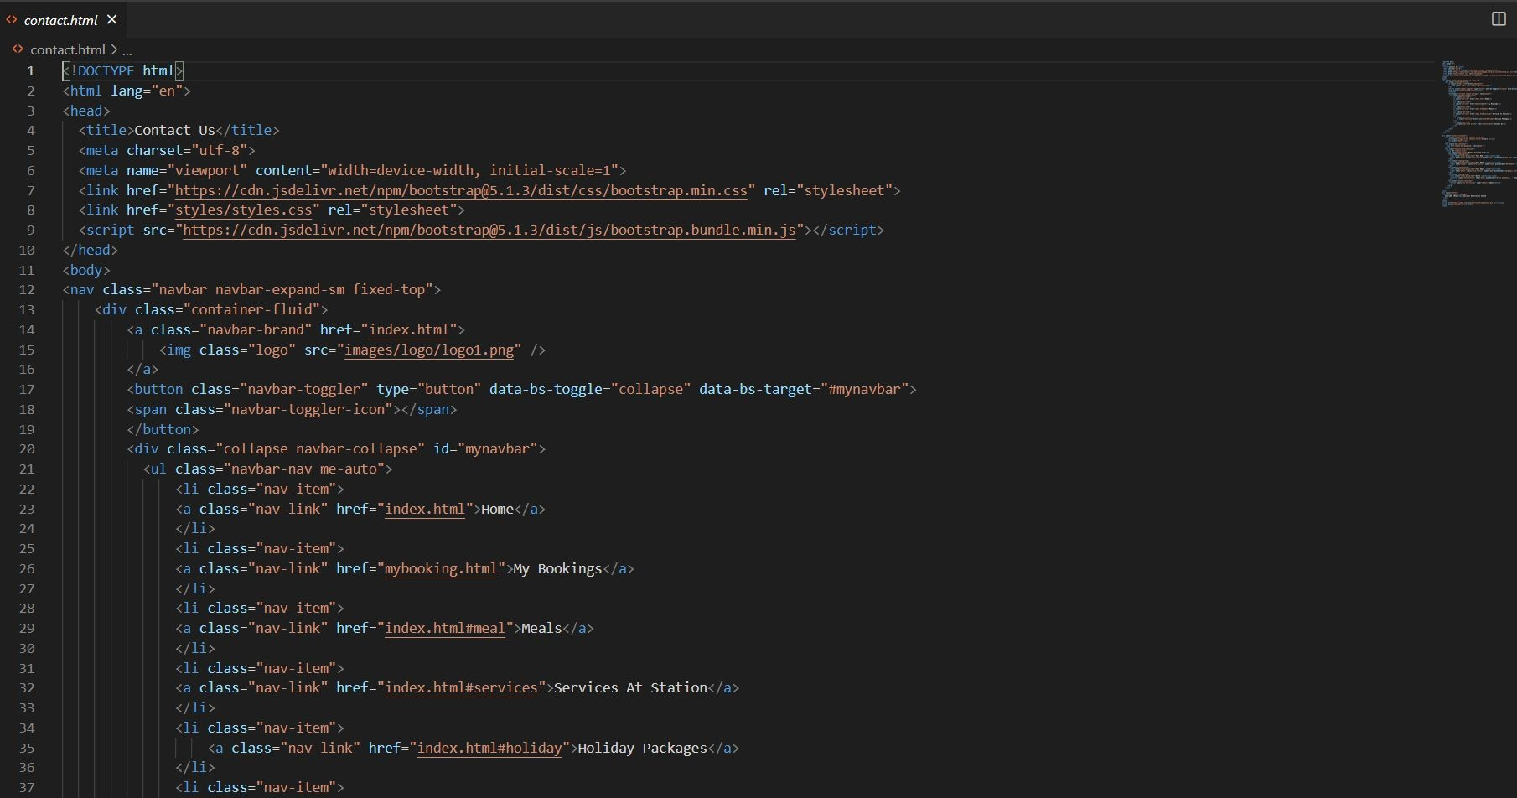
BY ASHWANI: CONTACT

Slide 14
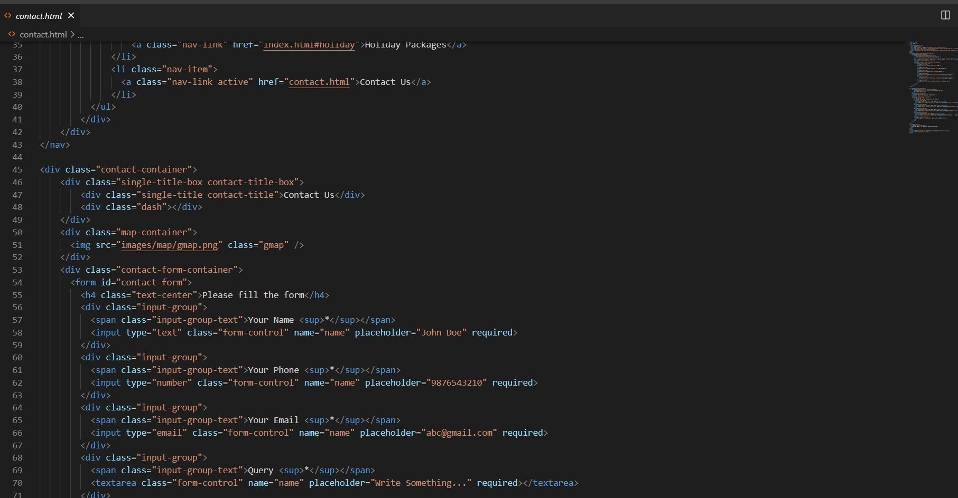

Slide 15
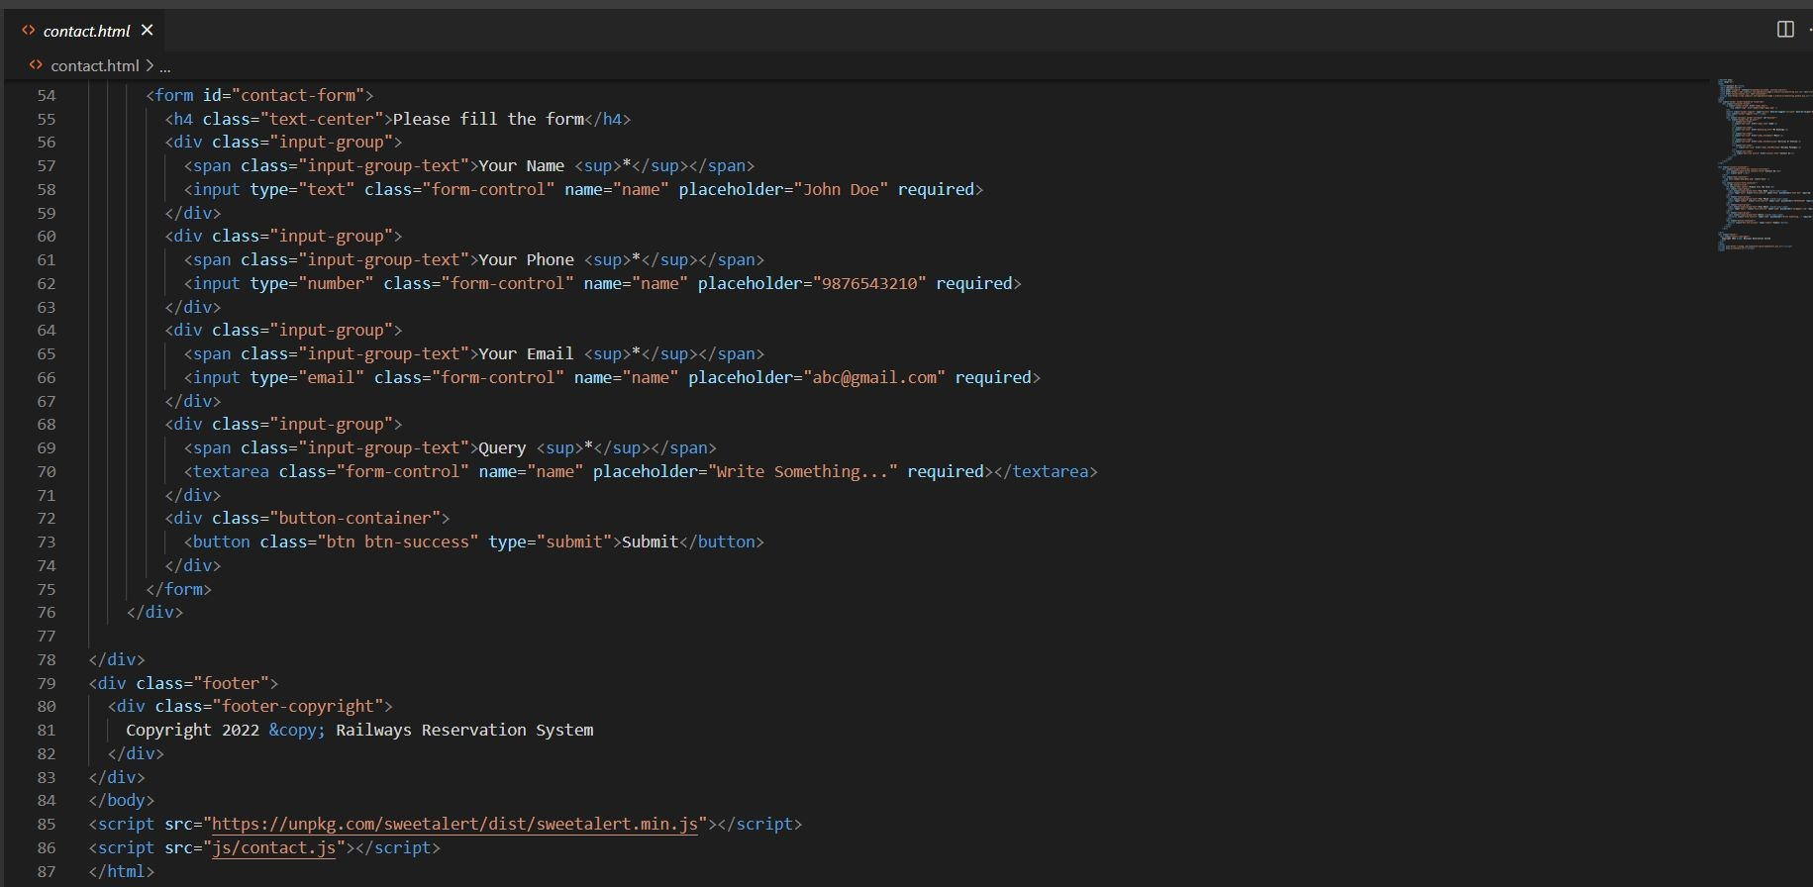

Slide 16
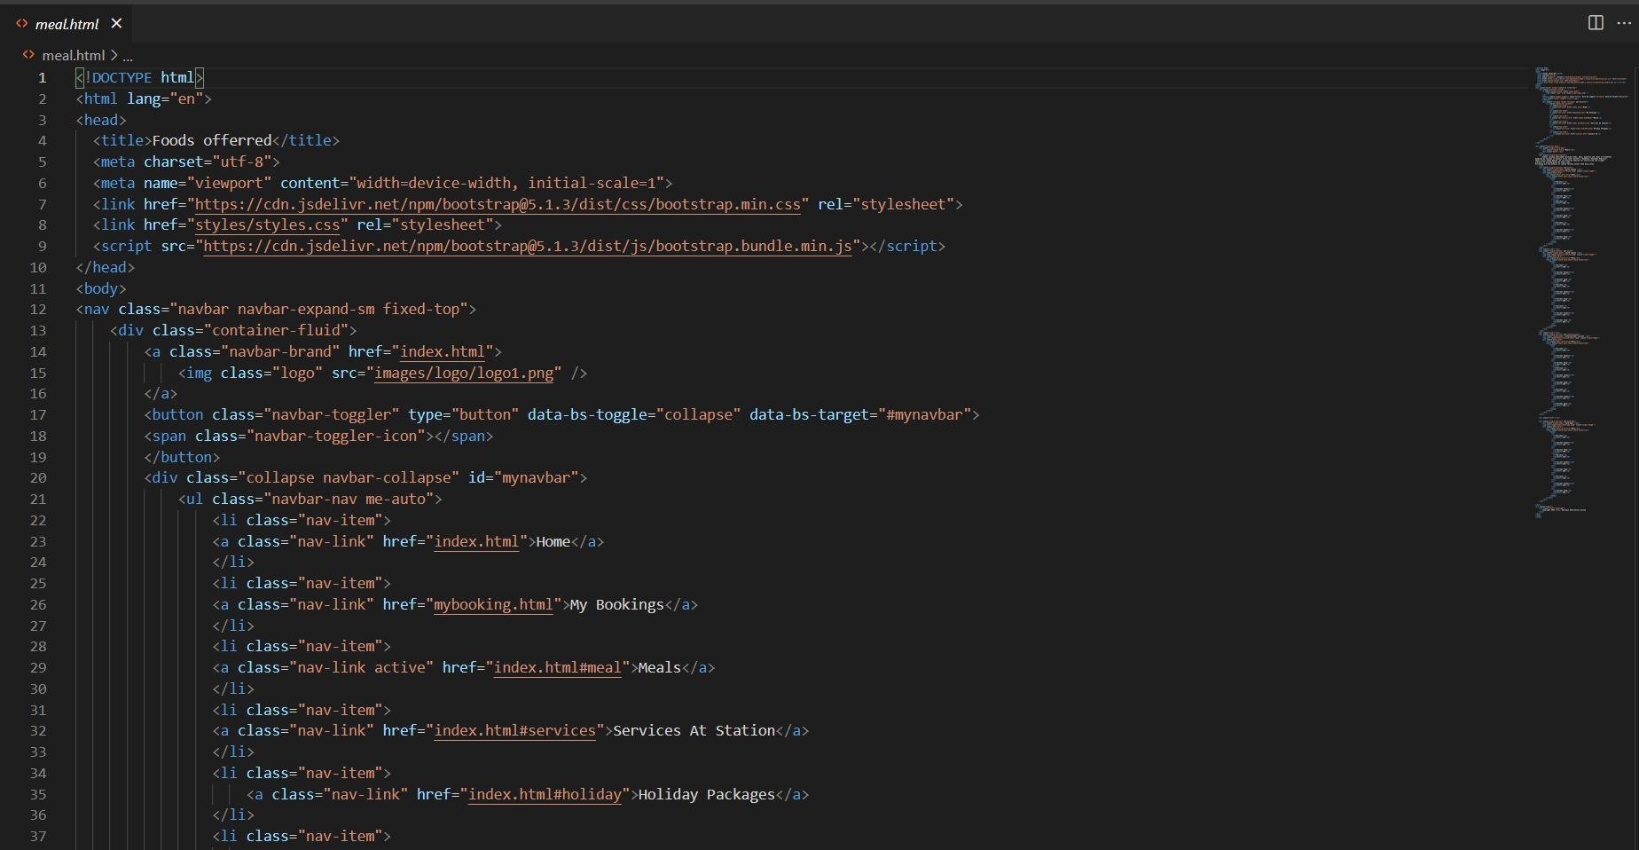
BY UTKARSH: MEAL
BY UTKARSH:

Slide 17
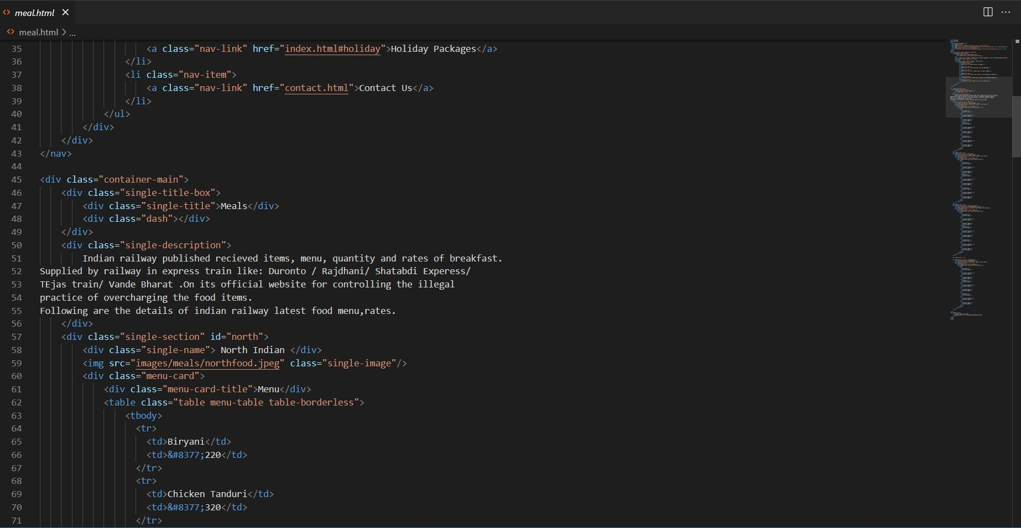

Slide 18
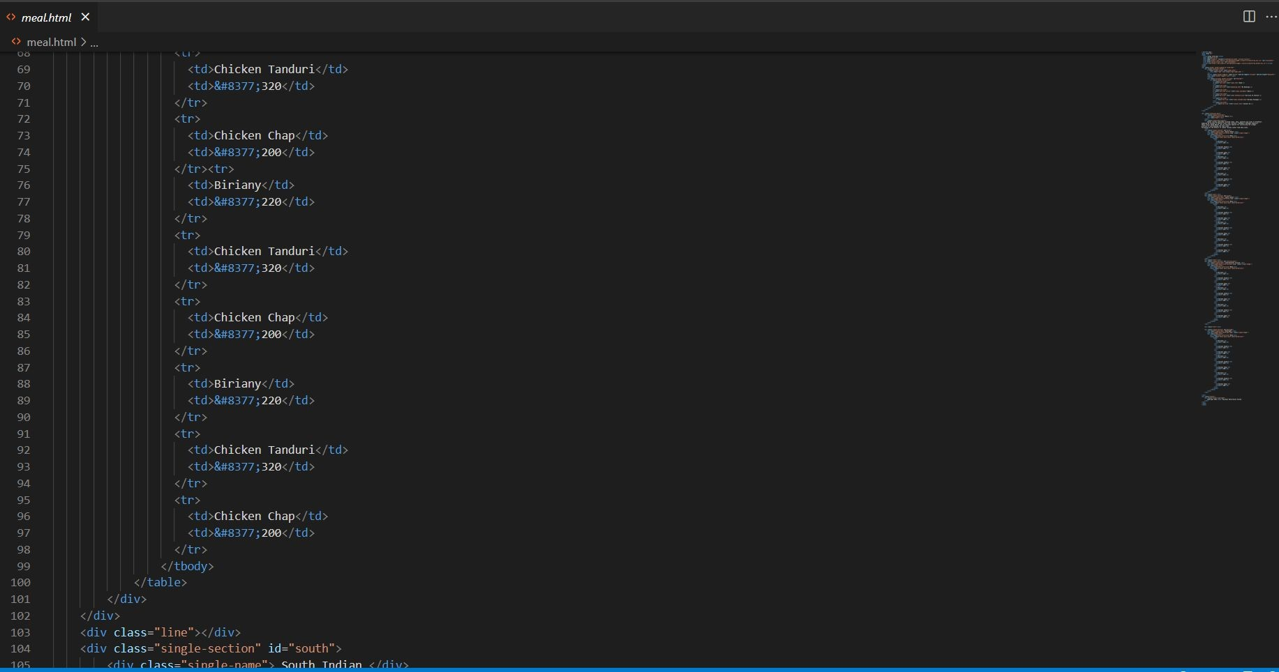

Slide 19
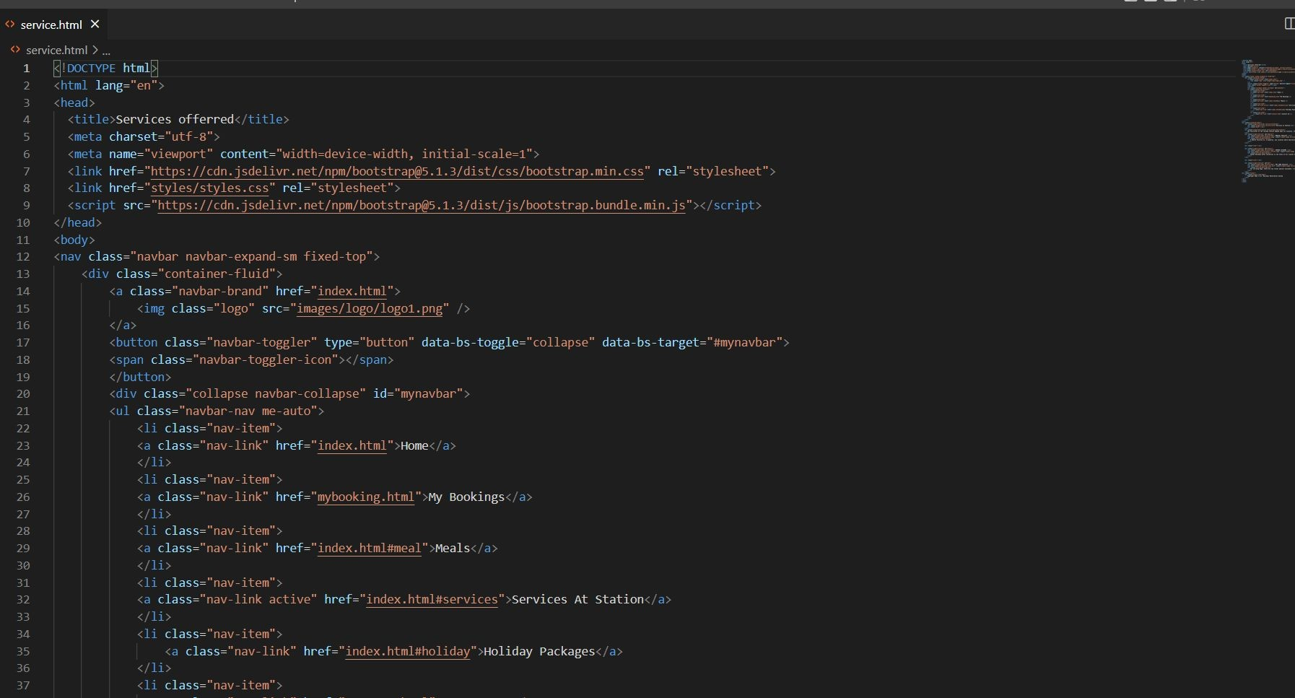
BY UTKARSH: SERVICE

Slide 20
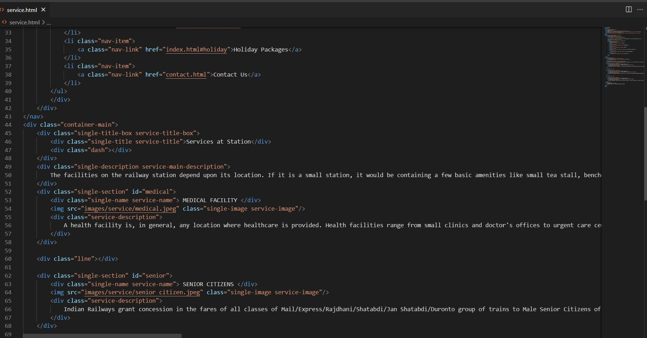

Slide 21
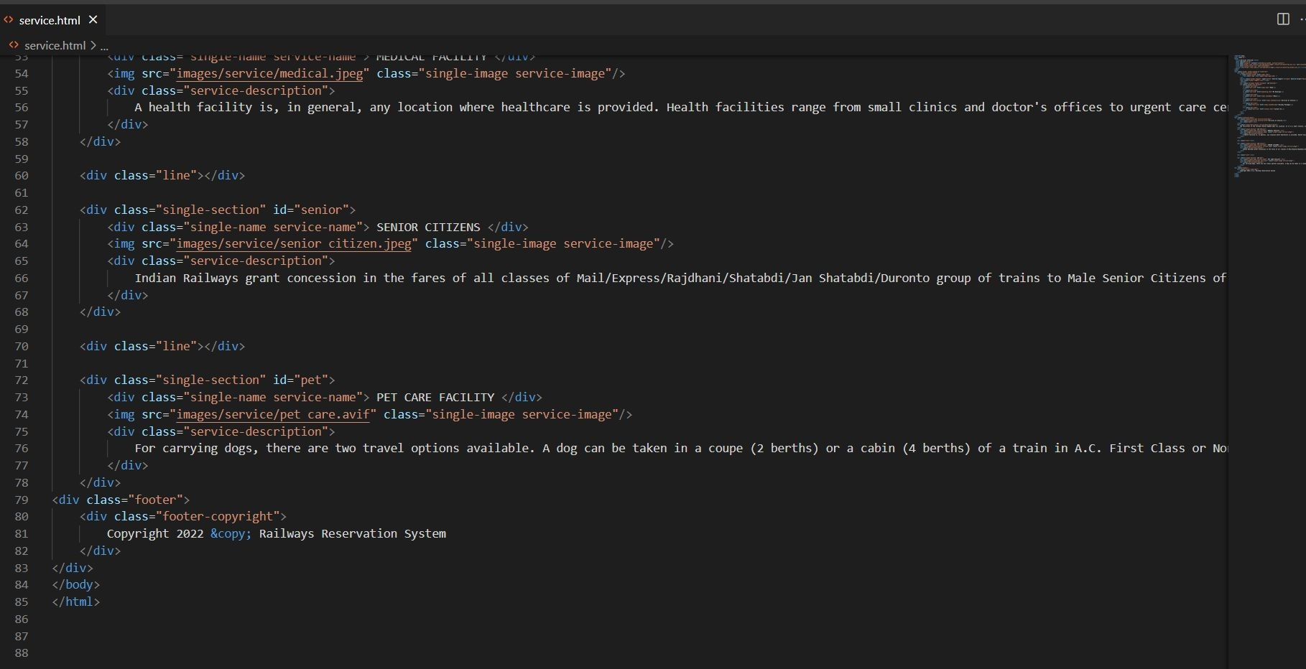

Slide 22
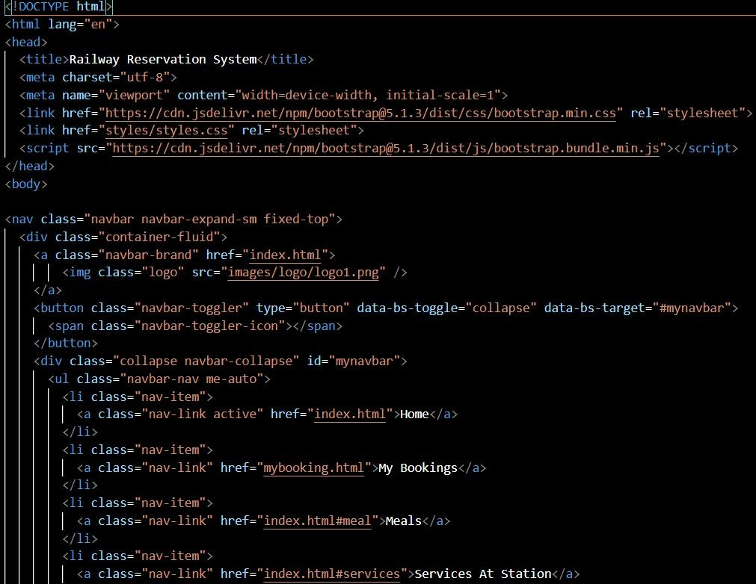
HOME PAGE

Slide 23
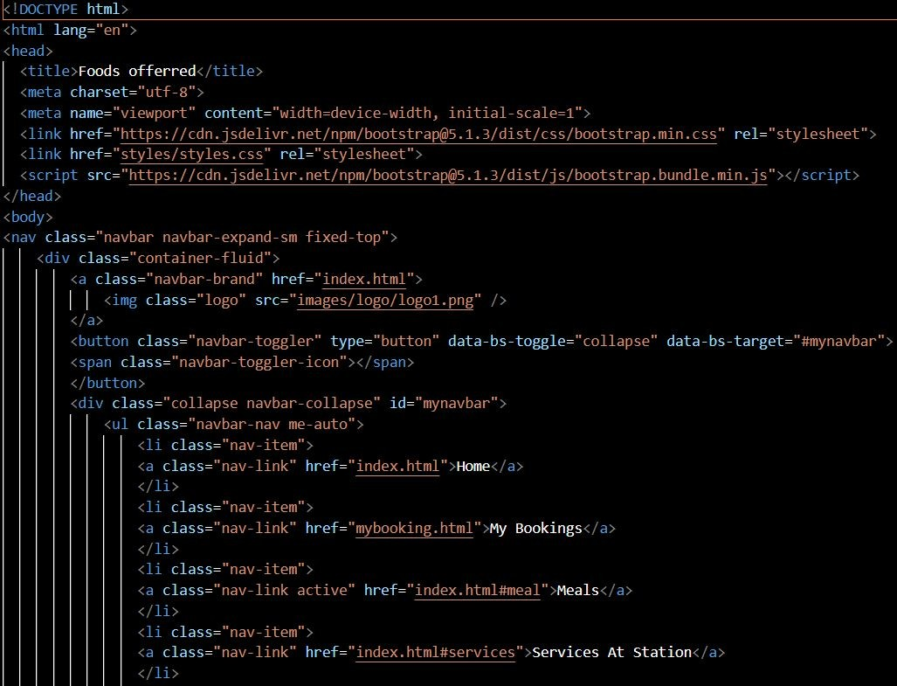
MEAL

Slide 24
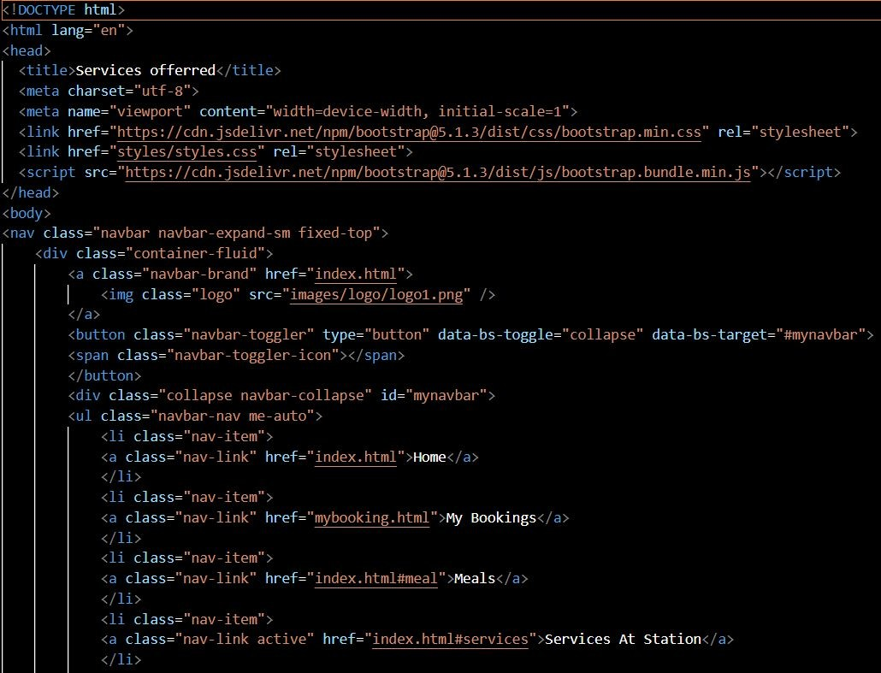
SERVICE AT STATION

Slide 25
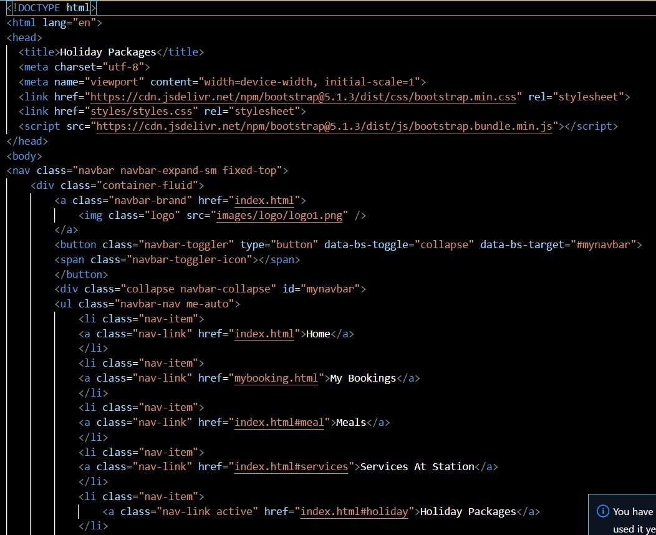
HOLIDAY PACKAGE

Slide 26
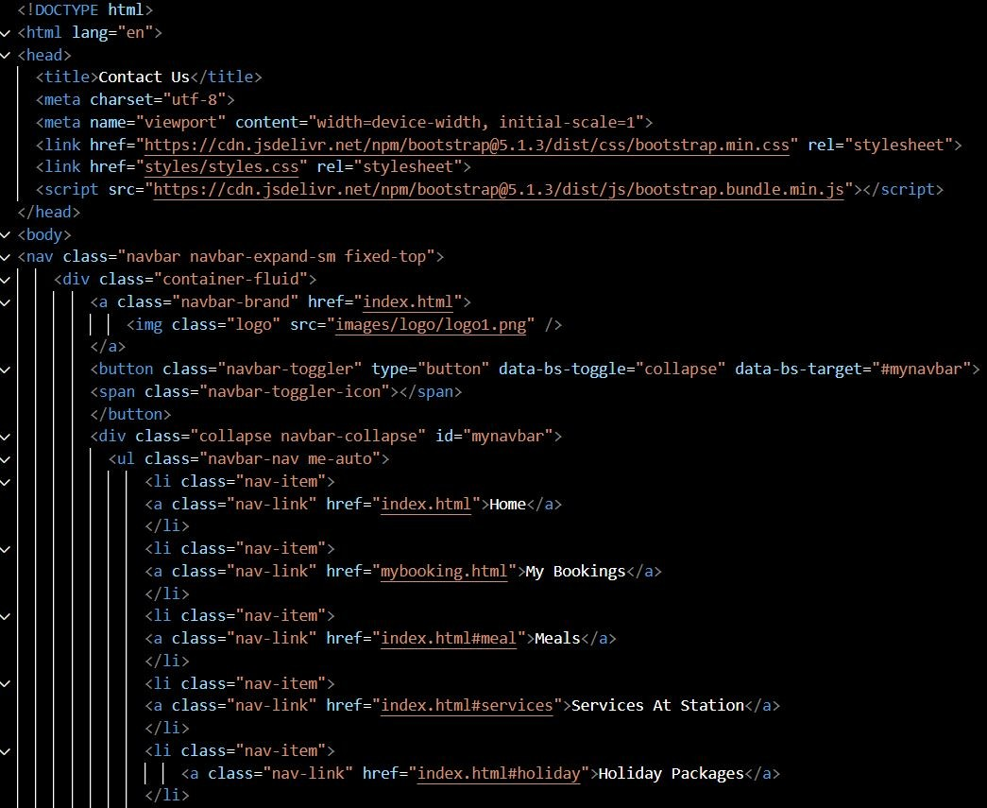
CONTACT US

